Slide 1
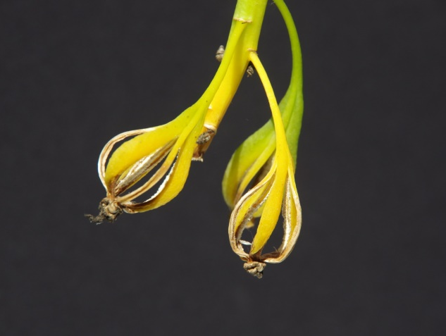
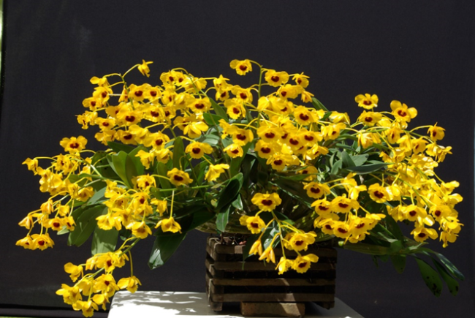
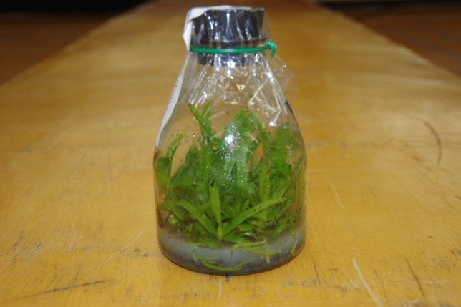
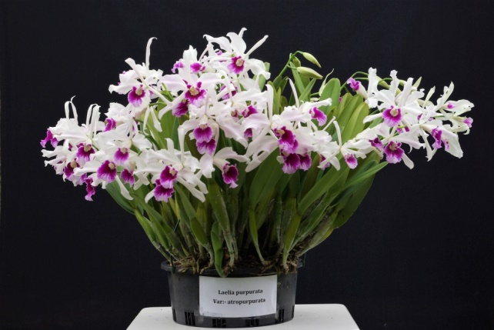
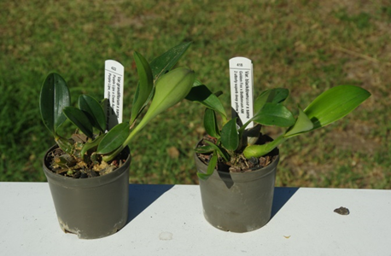
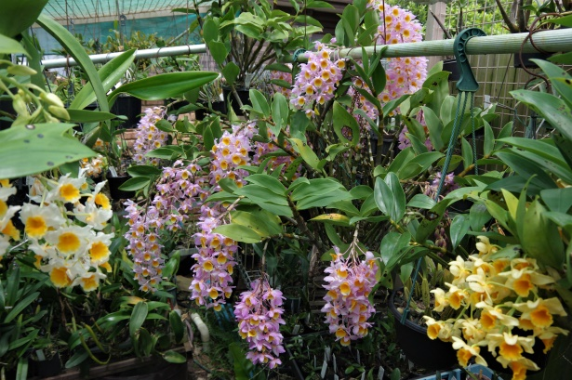
Orchids for New Growers By Gary Hodder

Slide 2
Orchid facts
In nature the orchid has one of the largest range of species of any flowering plant. Approx 30,000
The largest genera are the Bulbophyllum (approx 2000 species) Epidendrum (approx 1500 species ) and the Dendrobium (approx 1400 species)
The habitat is from the Arctic Circle to the southern most jungle in South America.
Some orchids first flowers won’t appear until at least 5 to 7 years after germination.
The orchid flower is the most popular flower sold in the world.
Orchids are the official state symbol of the many, mostly tropical countries.
The Kew Royal Botanic Gardens reported that between 200 and 300 new orchid species are being found every year,
About 80 percent of orchids grow in the tropics.
The smallest orchid blooms, from the cloud forests of Venezuela, are small enough fit on the head of a pin,
The world's tallest orchid, the Sobralia altissima from the forest of Peru, can grow to a mighty 13.3m tall.
Today there are over 100,000 registered hybrid orchids,
The orchid Vanilla planifolia. It's the only orchid that produces an edible fruit (yes, vanilla is fruit!).
Orchids have the tiniest seeds in the world. These plants can live to be up to 100 years old.
Depending on the species, the flowers of an orchid can survive for a period ranging from a few hours to six months.
Orchids do not have male or female flowers. When pollinated they have pod and pollen parents.
Some orchids have very special ways of pollination. For example, the Lady's Slipper can trap insects and make them pollinate the flower. Another instance is the Austrian orchid, which grows underground and is pollinated by ants.
The habitat of orchids. Ecuador has 3459 the highest registered species Colombia has 2723, New guinea has 2717 and Brazil 2590 species in all

Slide 3
Cattleya Orchids
There are somewhere in the range of 60 species of cattleya that are native to areas from Costa Rica south to Argentina. The number of hybrids and intergeneric hybrids (crosses with more than one genus) are too many to count. Cattleyas fall into two main groups: unifoliates (single leaf) and bifoliates (double leaf). These can be epiphytes and lithophytes and grow in dry conditions. Some species even grow on cacti.
There are two general types of cattleya hybrids: interspecific hybrids and intergeneric hybrids. Hybridization of cattleyas that occur between species within the same genus refers to inter-specific hybrids. Intergeneric hybrids, on the other hand, refer to cattleya orchid species inter-crossed with other genera.
"Slc." is the abbreviation used to describe hybrid orchids with parentage from three species: sophronitis, laelia and cattleya and from no other genera. These orchids are called "sophrolaeliocattleya" orchids.
“Blc” is the abbreviation used to describe hybrid orchids with parentage from three species: brassavola, laelia and cattleya and from no other genera. These orchids are called Brassolaeliocattleya;
“Rlc” is the abbreviation used to describe hybrid orchids with parentage from two species: rhyncholaelia and cattleya and from no other genera. These orchids are called Rhyncholaeliocattleya,

Slide 4
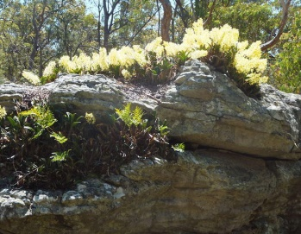
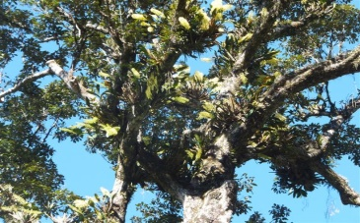
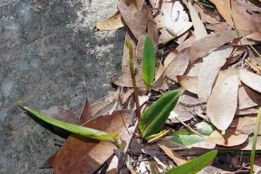
Orchids, Types, Varieties, Cultivars and Terminology
There are two types of orchids in the world
Species Orchid
The species orchids are the orchids that grow in the wild. There can be different forms of a species which can be due to location and can come in the form of:-
(1) lithophytes orchids that grow on rocks
(2) epiphytes orchids that grow in trees
(3) terrestrial orchids that grow in the ground

Slide 5
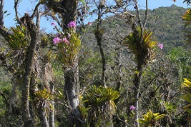
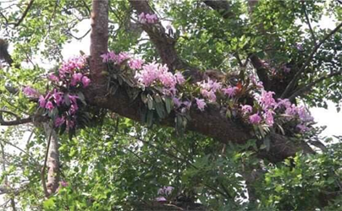
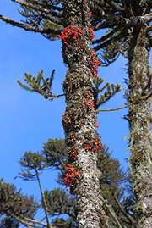
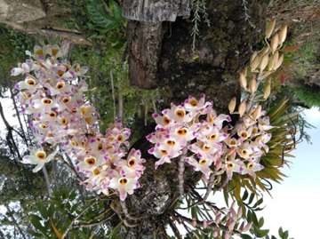
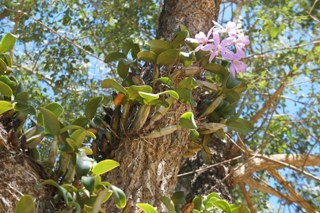
Some typical species of orchids growing in their natural habitat

Slide 6
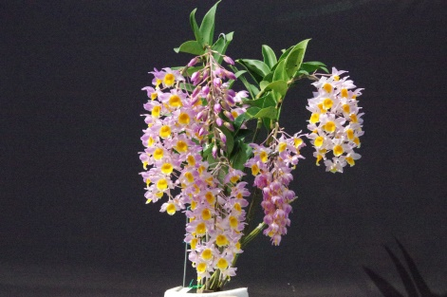
(b) Hybridized Orchid
A hybrid orchid is an orchid that has been pollinated from flowers by a nurseryman and can be flowers of the same genera or two totally different orchid flowers.
The orchids that are cross pollinated from the same species are known as cultivars.
Not all hybrids are man made. There are Australian native hybrids such as Dendrobium Delicatum and Dendrobium Gracillimum that are found naturally in the wild and have also been bred as plantation grown orchids.
Seedlings from the same pod can have a color range from one parent to the other. Seeds from pods that produced seedlings when flowered can produced many different colored cultivars.
A typical hybrid is the Dendrobium Mousmee.
To distinguish between a species and a hybrid, the Australian Orchid Council has said, that when writing the orchid name a species orchid has a lower case letter and a hybrid is to have a capital. i.e. Dendrobium farmerii and Dendrobium Mousmee.

Slide 7
Components of an Orchid
The ROOTS are generally a firm white color attached to the bottom of a pseudo-bulb and when actively growing have green tips at the end.
The LEAD is the new shoots.
The RHYZOME is the under ground stem that connects two pseudo-bulbs
The BACK BULB is a pseudo-bulb of an orchid that remains on the plant after the terminal growth has been removed as a division.
The PSEUDO-BULB is the storage organ found on sympodial orchids.
The SHEATH is the covering around a new flower.
The LEAF is the part of an orchid where its primary function is photosynthesis and can be flat or round.
The INFLORESCENCE is the flowering part of the plant.
The BUD it the new flower that has not opened.
The BLOOMS are the actual flowers once they are open.

Slide 8
Components of an Orchid flower
The orchid flower has three sepals, one dorsal sepal at the top and two lateral sepals one on each side. Three petals, one on each side and the lower lip, also called the labellum. The column and anther cap are the reproductive area of the flower.
The inflorescence includes the whole flower raceme, spike or stem where the flowers emerge.
The Anther is the part of the flower that carries the pollen.
The Column is the reproductive organ unique in the orchid family that contains both female and male parts.
The Raceme is a type of flowering shoot in which the growing region at the tip of the flower stalk continues to produce new flower buds during growth.
The Bloom is the actual flowers once they are open.

Slide 9
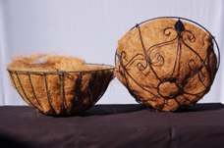
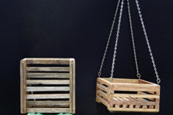
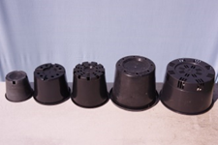
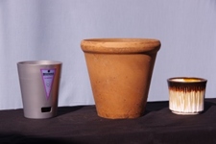
Orchid containers or pots. There are many different shapes, designs and materials for Orchid pots depending upon the species or hybrids and where they are grown. Some typical examples are shown below:- Hanging baskets made with a coir lining Timber slated hanging baskets. Squat black plastic pots. Terracotta or Ceramic coloured pots. Water well pots having an internal lip to retain a small amount of water.

Slide 10
Not all orchids need to be grown in containers as some growers like to their orchids growing many different ways such as :- on tree stumps or tree branches. on course bark or tree fern slabs. On cork slabs.

Slide 11
Potting Media Used for Orchids. There are many potting materials used by Nurserymen and Hobby Growers and these include some of the following:- . Pine Bark . Charcoal . Scoria ( Volcanic rock) . Perlite . Crushed Limestone . Agricultural foam . Moss such as Sphagnum Moss or Bush Moss The main reason why a lot of these products are used is to open up the media to allow air to circulate to prevent water collecting and causing root rot. If the air flow to the root system is stifled long enough, the gas exchange is compromised, and the roots die due to a combination of suffocation from the lack of oxygen, and poisoning by its own waste gases. Once the root tissue dies, the natural resistance to pathogens is eliminated, and the roots will rot. These roots will be brown very soft and squashy. Rather than suffocating our plants at each watering, the better approach is to prevent the extensive occurrence of bridging water in our potting media, and keeping the spaces larger is the key:

Slide 12
Treating of bark for an orchid potting mix.
Untreated pine bark from the landscape supplier has harsh toxins and phenols in it that will slow root growth only purchase bagged orchid bark.
When you purchase a orchid bark potting media in a bag there are a lot of fine materials and rubbish, so all my bark potting media is treated by me.
I generally empty the entire contents into a plastic garbage bin then fill it with clean water and let it soak for a day.
Then I empty the water and sludge from the garbage bin and fill with clean water again for another day.
I then empty the water and sludge again and fill with clean water again. But this time I add soluble fertilizer at the rate of 1gm per litre and let it soak for 5 days to allow the fertilizer to really soak into the bark.
I empty the water and let the bark dry out. This is now ready to use.

Slide 13
Fertilizers Fertilizer types There are basically two different types of orchid fertilizers. When choosing a fertilizer always read the label for N. P. K. ratio The N-P-K ratio, the percentage the product contains by volume of nitrogen (chemical symbol N), phosphorus (P), and potassium (K). A 19-2.5-17 fertilizer, for example, contains 19% nitrogen, 2.5% phosphorus, and 17% potassium. Organic Fertilizers. Naturally occurring organic fertilizers include animal wastes from meat processing, peat, manure and vegetable matter. These fertilizers depend upon the micro organisms to break them down and release the essential nutrients. Organic nutrients are rich in phosphorous, nitrogen, and potassium, but in unequal proportions. The big problem however is the natural occurring enzymes break down the bark potting media, quicker than chemical fertilizers. REMEMBER ONLY FERTILIZE IN THE GROWING OR FLOWERING PERIOD.

Slide 14
Chemical Fertilizers.
In chemical fertilizer There are also two different types .
Slow release.
Granular (Soluble type fertilizers).
A chemical fertilizer is defined as any inorganic material of wholly or partially synthetic origin that is added to the potting media to sustain plant growth and flowering.
Slow release fertilizers are generally granular and are scattered around the surface of the potting media. They rely on heat and water to break down into the potting media. Read the label as it may say 6 months release, however if the ambient temperature is higher than 27 degrees C they will break down quicker.
Soluble fertilizers are generally mixed with a liquid such as water and sprayed onto the orchid or potting media. The dilution rate is critical because if the mixture is too strong it will burn the roots or flowers and damage the plant. Remember it is better to fertilize WEAKLY, WEEKLY.

Slide 15
Fertilizing of my orchids. Fertilizing orchids is an essential part of growing good plants. I use a variety of chemicals for different results. Besides the application of a chemical fertilizer every 10 days in the growing and flowering periods, I also use a combination of Epsom Salts (75gm per 100 litres of water) and Condy’s Crystals (5gm per 100 litre of water) at least twice a year in the spring and in the autum. Also twice a year I use 50% Dolimite and 50% Blood and Bone which is sprinkled over the foliage and pots just prior to rain, but if the rain does not wash all the residue into the potting media then I use the hose to water to remove the remaining residue. This is to readjust the pH and sweeten the freshness of the growing media.

Slide 16
The photographs below show the results of fertilizing. All 4 seedlings are from the same pod and the plants fed in different ways. The plants were all Den speciosum var. speciosum “Dreamtime” crossed with Den speciosum var. speciosum “Heather” AM/ANOS and were obtained from Ross & Ronda at Cedarvale Orchids at the Southern Orchid Spectacular in 2016. The pot on the left was given no fertilizer at all. The next pot was only given Blood and Bone on top of the potting media. Then the 3rd pot was fed with a fertilizer readily available to the general public, mixed with water and sprayed on the plant. The last plant was fed with a specialised commercially available fertilizer, having an N.P.K. 19:2.5:17 plus trace elements but is not available to the general public. This was mixed with water and sprayed on the plant.

Slide 17
Watering More orchids die by incorrect watering than any other cause. Water your orchids only when they need it. Plants need water for the process of photosynthesis. They need water when they are in active growth and they need water when they are transpiring heavily. From this it could be said that for plants under shade-house conditions, it is almost impossible to over-water in summer and conversely it is almost impossible to under water in winter. This is assuming of course that the orchids have adequate drainage. Water should never be able to pool in pots. Here are some precautions to overcome problems with watering of orchids. 1) Never water any orchids when the ambient temperature is above 27 degrees C. The best method is to wet the ground under the benching, this will increase the humidity and cool the plants down. 2) Never water an orchid if the ambient temperature is below 10 degrees C. Some orchids don’t mind being cold. They don’t mind being wet but when you combine the two ie. cold and wet it is a disaster and chances are that they will die. 3) Never allow water to collect in the new growth where the leaves join the canes as the water will pool and fungus will develop and this area will go black and the leaf will die and drop off. 4) With Phalaenopsis orchids it is better to immerse the pot in an ice cream container so that the water only reaches just below the level of the potting media top level for half an hour then let it drain. This will prevent crown rot which will kill the orchid.

Slide 18
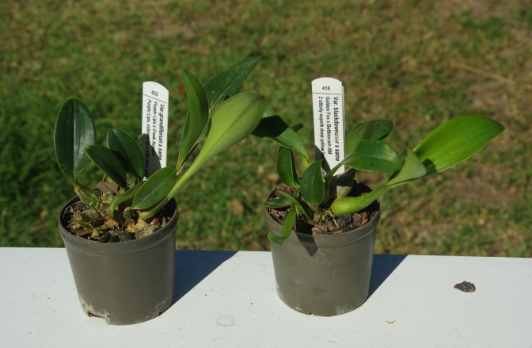
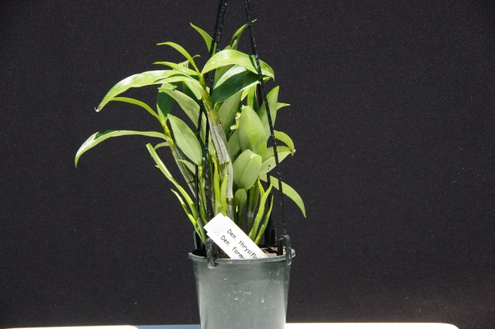
This section is directed to the novice members of the Orchid Society.
For a novice grower it is far better to purchase a well established plant rather than a small seedling as the chance of survival is far greater for an advanced plant.
Typical example of a seedling
For the novice it is better to purchase a well established plant in say a 100mm dia. pot

Slide 19
Re-potting of an orchid. Orchids can be re-potted in several ways. Firstly they can be potted on, where the plant is removed from the pot and placed into a larger pot. The second method is where the plant is removed from the pot and cut into many divisions all being re-potted into individual pots, or in some cases they can be secured to bark or cork. But remembering not to select a pot much bigger than the individual plant. Once an orchid is re-potted, it is essential that it be re-potted every two to three years as the media becomes “stale” over time, the media breaks down increasing the P H and the media in the case of bark, becomes dirt and the roots are unable to breathe. The roots smother killing the orchid, as they require oxygen to survive. Re-potting should take place when the roots are actively growing indicated by the green root tips as can be seen below. This time is generally after flowering.

Slide 20
Problems that affect Orchid growth
Sap Feeding Insects
Scale
Mealybug
Aphids
White Flies
Spider Mites
Thrips
Chewing Pests
Snails and Slugs
Caterpillars
Roaches
Grasshoppers
Dendrobium Beetles
Ants
Rats and mice
Damaging to New Growth
Cold Wet Weather
Sunburn
Fertilizer Burn
Salt toxicity
Trace element deficiency
Fungi
Glomerella Fungi
Crestor Dendrobii
Colletotrichum Fungi
Phyllostichum Fungi
Phytophora Rot (Brown Rot)
Pythium Rot (Black Rot)
Viruses

Slide 21
When spraying chemicals onto orchids always remember the following hints:-
Many chemicals work better if mixed in water with a pH below 6.0.
Never spray where the air temperature is above 25 degrees C.
Always check to make sure the wetting agent is not petroleum based.
Never spray chemicals on the flowers or buds as they will mark.
Never use sprays that have been mixed more than 8 hours.
If you use dishwashing liquid as a wetting agent it will raise the pH level.
If spraying for nocturnal insects spray at sunset or later
Spray all surfaces of the orchid not just the upper surface of the leaves.
Most fungicides work best by themselves read the label.
Read the directions on the container label before using the product.
When spraying aggressive chemicals always use protective clothing

Slide 22
Virus
Keeping a virus free collection does not come easy, but it can be achieved with some effort. There are many ways to stop virus getting into your collection as shown below.
Only purchase healthy plants.
Place newly purchased plants in quarantine for several months.
Good sanitation within the orchid house.
Always sterilize your cutting tools between orchid procedures.
Use clean newspaper on the bench for each plant when repotting.
Remove all insects as they can carry virus.
Wash hands after touching each orchid.
Do not reuse old potting media or unsterilized used pots.
There are approx 33 different viruses that attack orchids.
Test kits are available to test for virus but only for 3 different ones.

Slide 23
You cannot do anything about a plant once it is infested with virus. There is no treatment and no cure, so you must at least isolate an infected plant from non-infected plants, and preferably destroy it by burning or wrapping it in plastic placing in the garbage bin and not the recycled bin.

Slide 24
ORCHID CULTIVARS
One of the main points to remember is that if you purchase a hybrid between two species it does not mean that you are automatically going to get an award winning flowering plant.
Even if you copy the cultivar it does not mean that every cultivar is going to be an award quality flower. E.g. Take for example Dendrobium “Avril’s Gold” which has so many different colours and flower shapes.
I once cross pollinated two soft cane Dendrobiums (Shinome No 7 and Golden Blossom) and from the seed pod the seedlings grew and when they flowered many years later there were twenty one different coloured flowering plants as the genes can range from one parent to the other.
You can purchase 50 seedlings say Dendrobium speciosum curvacaulie “Daylight Moon” but it does not mean that every plant will be an award quality plant as not every “Daylight Moon” used in breeding is the exact awarded plant. The chances are that only one will be top quality.

Slide 25
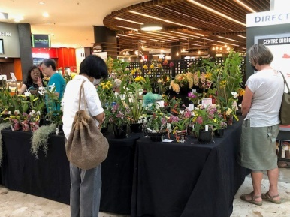
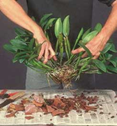
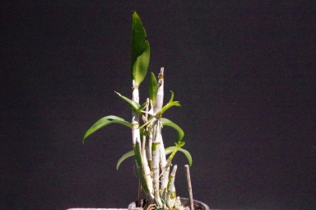
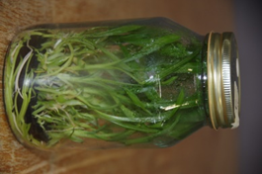
Ways to increase your orchid collection
Purchase new orchids from vender at
orchid shows, The Internet or
Orchid Nurseries.
Subdivide mature healthy plants.
Remove kiekies from parent plants.
Grow from seed or purchase flasks.

Slide 26
The way the Asians increase their orchids
Another method they use is once the orchid has finished flowering they cut the cane and seal both cut surfaces with Aloe Vera sap. They then cut each cane into sections where each section has 3 eyes or nodes. These cut sections are then laid on a bed of coconut fibre and watered with a solution and kept moist.

Slide 27
They then water all the new cuttings with a solution made up from :- one teaspoon MSG half teaspoon honey 200 ml hot water This is then stirred and allowed to cool. Banana peel is then cut into 3cm lengths and placed in a bottle and covered with water then allowed to sit for 1 week. They are then mixed together and sprayed over the orchid.

Slide 28
Banana peels contain lots of nutrients, including potassium, phosphorus, magnesium and calcium. For fertilizer they place Banana peel in the sun and allow then to fully dry until they are totally black and dehydrated. These dried skins are then put through a hammer mill and the powder is placed on top of the potting media about 12mm thick.

Slide 29
Although banana peels have a high concentration of potassium, fresh banana peels should never be used on orchid due to the ethylene gas that is given off which poisons the Orchid and then eventually over a period of time dies.

Slide 30
Simple method of increasing your collection for Dendrobiums

Slide 31
Australian Orchid Council Awards
Since January 1999, all orchids are judged by general appreciation rather than the former regimented system of points for certain features of the bloom. A panel of at least five fully accredited judges is required to make an award. The panel then passes the application, photos etc on to the Australian Orchid Council's Registrar General via the state Deputy. Awards are now shown thus: FCC/AOC (year).
The following are the AOC Awards Categories:-
FCC First Class Certificate 85 points or more of possible 100.
AM Award of Merit 80 to 85 points.
HCC Highly Commended Certificate 75 to 80 points.
AD Award of Distinction Awarded for distinctive attributes e.g. color
CBM Certificate of Botanical Merit
ACE Award of Cultural Excellence 85 points or more of possible 100
ACM Award of Cultural Merit 80 to 85 points
ACC Award of Cultural Commendation 75 to 80 points
ASR Award of Special Recognition

Slide 32
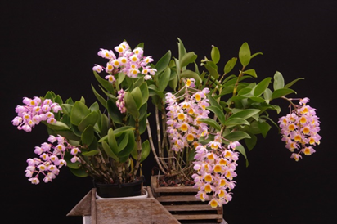
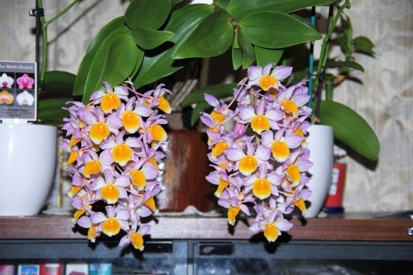
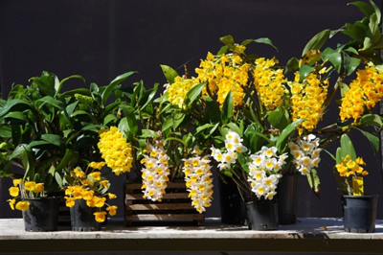
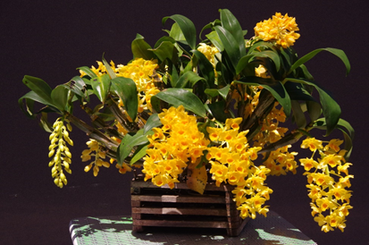
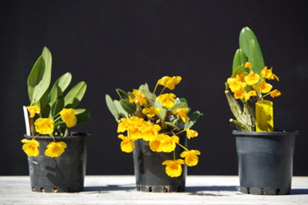
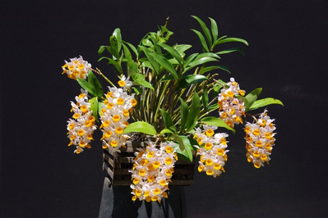
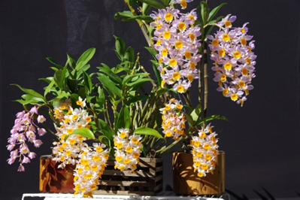
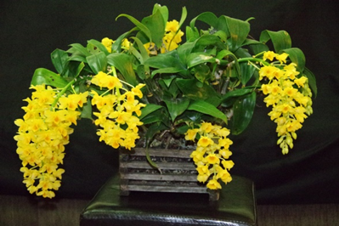
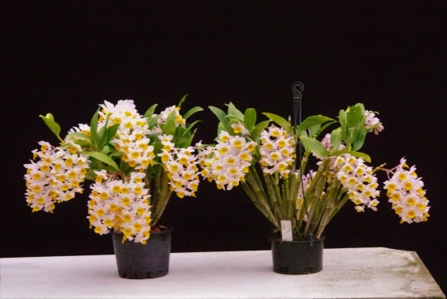
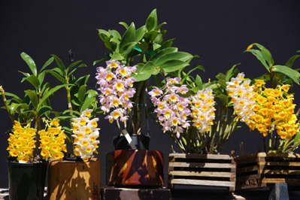

Slide 33
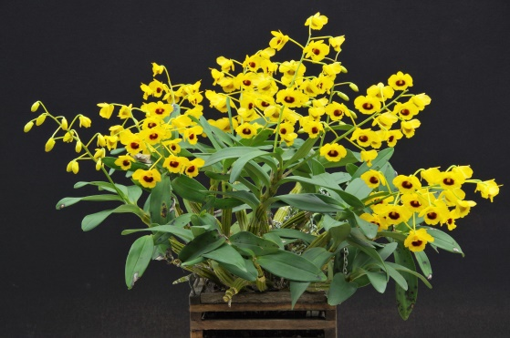
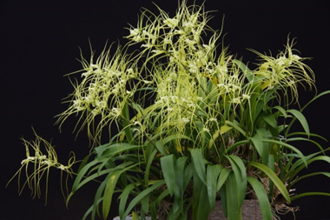
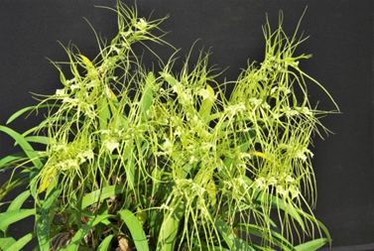
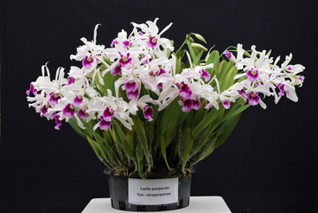
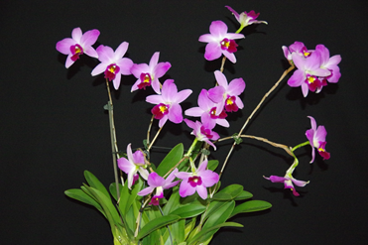
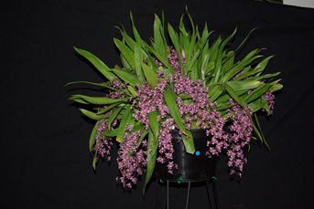
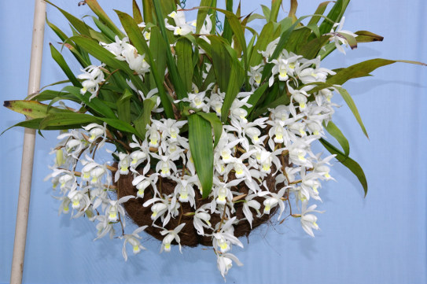
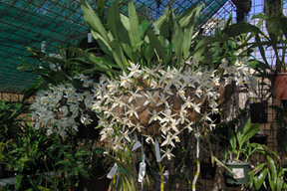
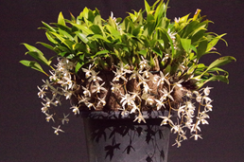
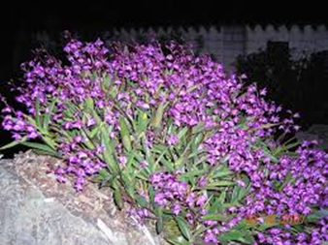
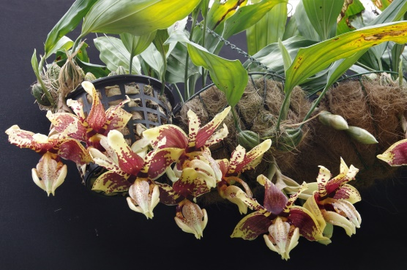
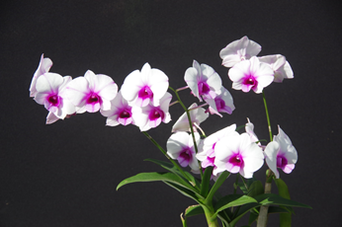

Slide 34
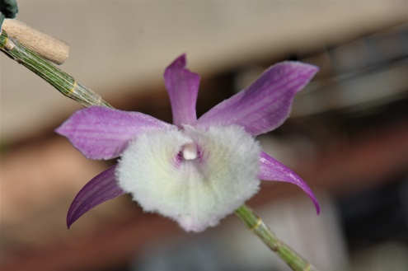
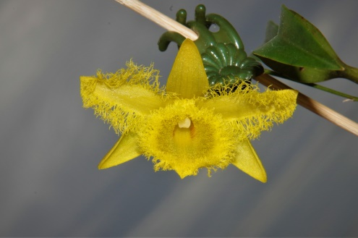
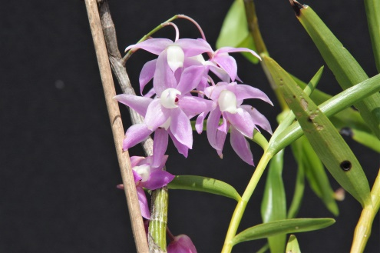

Slide 36
ACKNOWLEDGEMENT I would like to acknowledge the following people as without their help and assistance this presentation would not have been possible. The Late Mr Alan Merriman. Mirann Orchids Blue Mountains N.S.W. Mr Graeme Davies. Thank you for your attention and interest THE END.f1

